Slide 1
WEBINAR:
Addressing the Software Testing & Compliance Challenges For Healthcare Providers with the Move to Cloud Computing
We will be starting the webinar shortly, please stand by…
All phones will be automatically on mute until the Q&A.
March 7th, 2018 – Adam Sandman

Slide 2
WEBINAR:
Addressing the Software Testing & Compliance Challenges For Healthcare Providers with the Move to Cloud Computing
March 7th, 2018 – Adam Sandman

Slide 3
Agenda
The Needs of the Healthcare Industry
Why does the Cloud Change Everything?
Overview of the Inflectra Platform
Managing Testing & Compliance with SpiraTeam
Automating Test Cases with Rapise
Q&A

Slide 4
Challenges in the Healthcare Industry in 2018

Slide 5
What are some of the top challenges?
Increasing numbers of Government regulations:
  Data Privacy (GPDR, HIPAA)
  The ever-changing ACA
  FDA, Medicare, Medicaid, etc.
Consolidation of Health Care providers
  Integrating their systems and processes
Increasingly complex systems
  Billing, pharmacy, medical records
Reduction in testing and validation budget

Slide 6
What are some of the top challenges?
Validation of all systems
  CFR Part 11 compliance
  Need to test all systems
  Need to test the testing systems!
Drive for Agile Development
  How to be Agile and compliant?

Slide 7
What does the Cloud Mean for Healthcare Providers?
Why Migrating to the Cloud Changes Everything!

Slide 8
Opportunities
Offload the infrastructure to “experts”
Outsources change control of the infrastructure
Enhanced reliability and availability
Potentially higher security
Best practices “baked in”

Slide 9
Challenges
Cloud environments update frequently
  Manual paper-based validation and change control will not be feasible any more
The change control and validation processes are shared between the cloud provider and the application owners
You cannot simply validate the cloud platform
Similar challenges to the GDPR in Europe
  Data controller vs. data processor
Who is responsible?

Slide 10
The Inflectra Solution
How we can help you automate your testing and compliance to be ready for the move to the cloud.

Slide 11
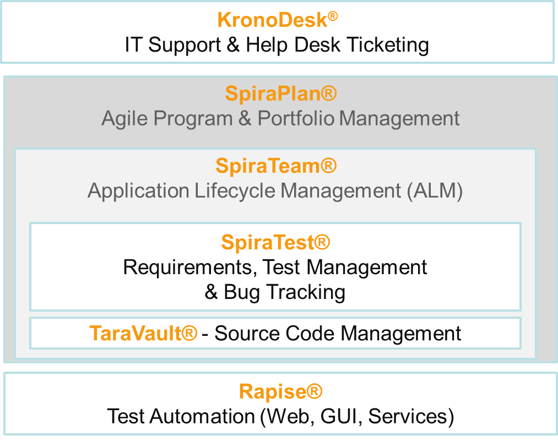
Inflectra Product Suite
Requirements and Test Validation Platform
Test & Process Automation

Slide 12
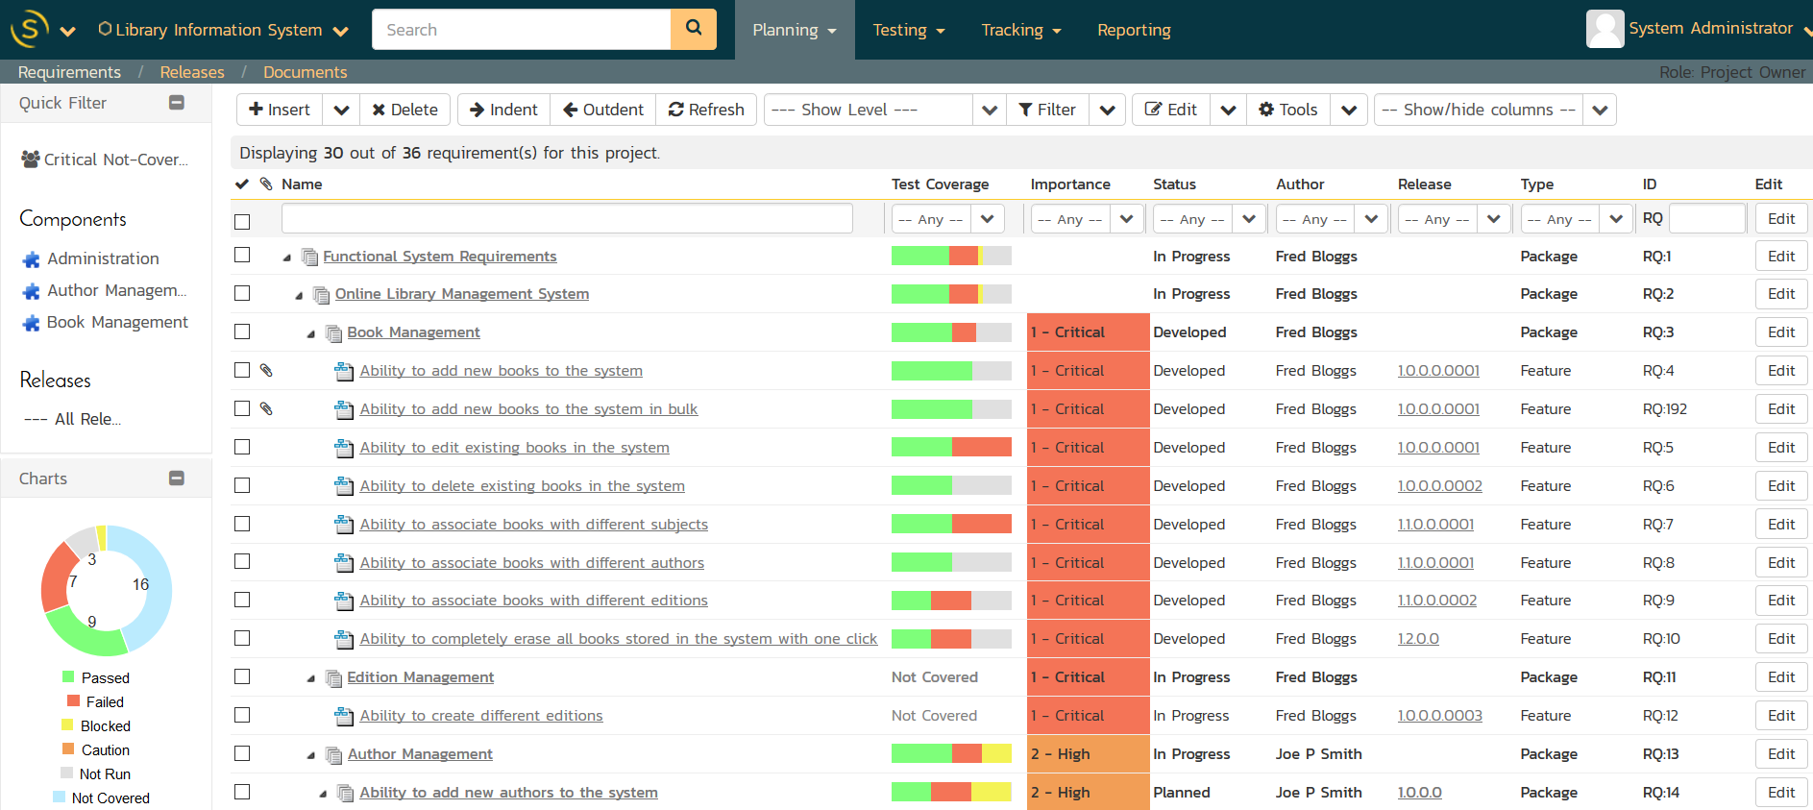
Requirements & Test Validation

Slide 13
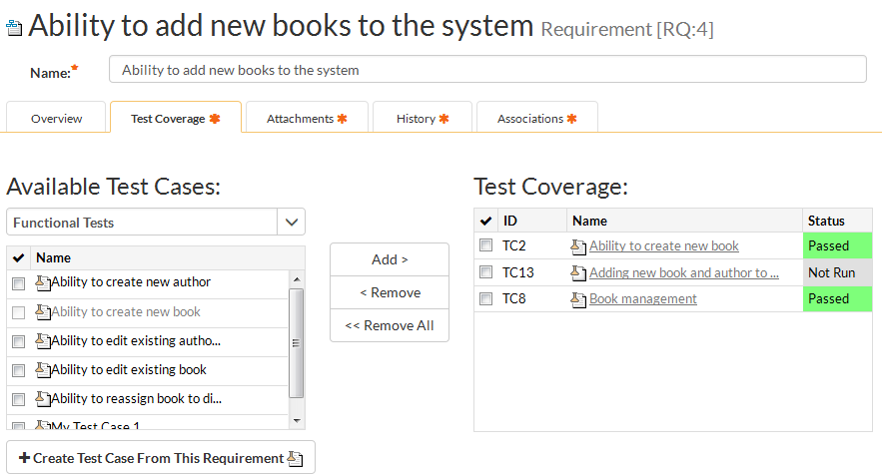
Requirements Traceability

Slide 14
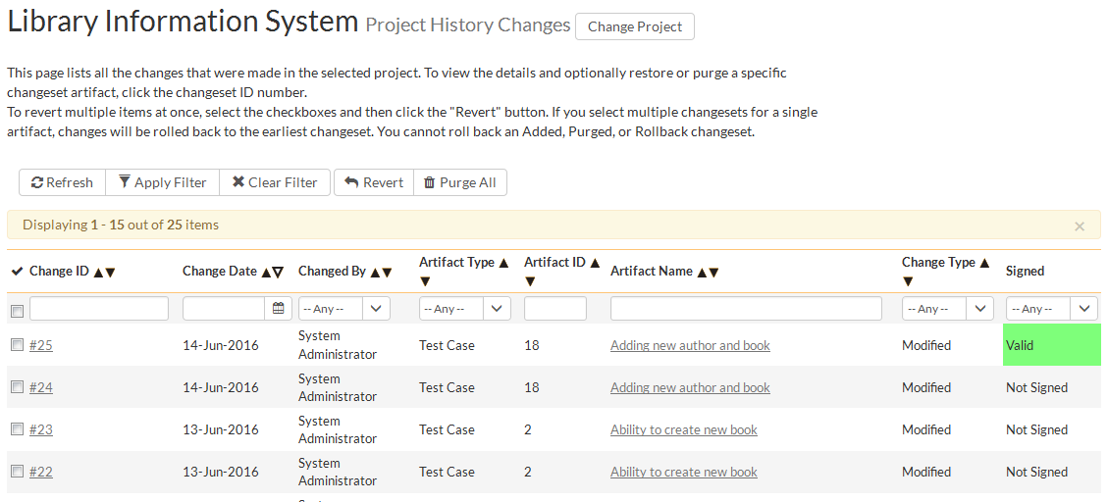
Audit Logging & Trail

Slide 15
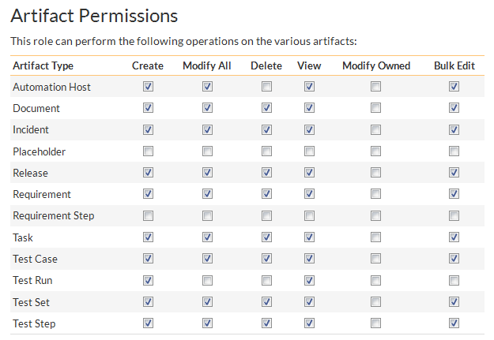
Controlled / Secure Access

Slide 16
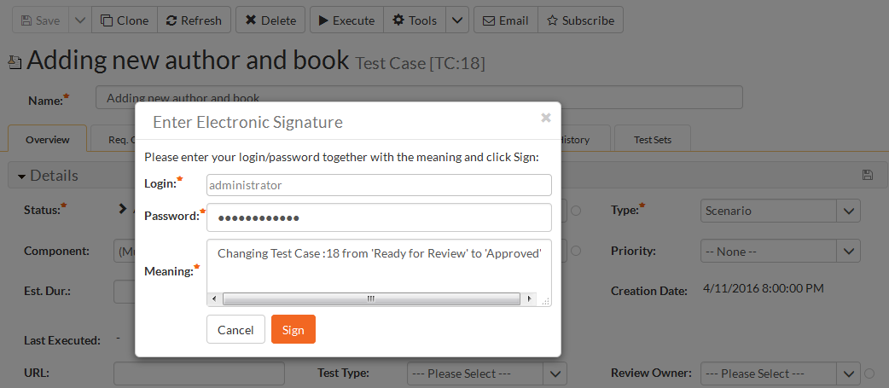
Workflow & Electronic Signatures

Slide 17
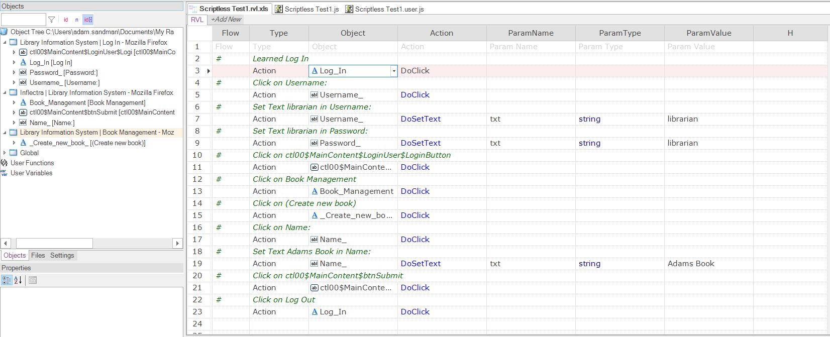
Automated Testing & Validation

Slide 18
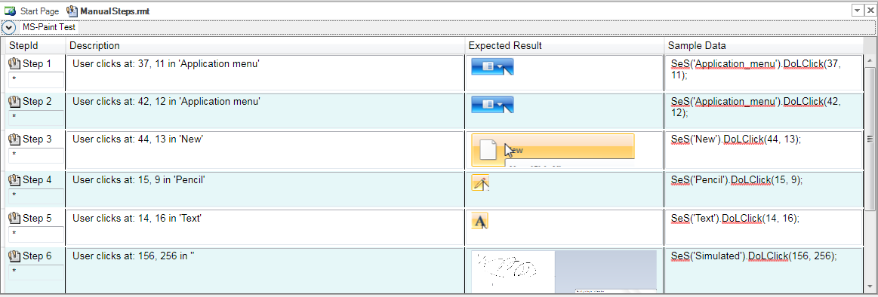
Automated Application Documentation

Slide 19
Application Demo

Slide 20
Questions?
Please feel free to unmute your line, raise your hand, or simply write your question in the Chat window.

Slide 21

Thanks for Watching
Subscribe to Our Channel for More Videos on Software Testing
http://www.youtube.com/inflectracorporation

